Slide 1

 | AI Resume Analyzer using NLP Techniques
Indian Institute of Technology Guwahati BSc. (Hons.) Data Science & Artificial Intelligence Online Degree Programme
 | Student Name : Student ID : Email ID : Programme : Course Code : Course Name : Trimester : |  | Aman Chaudhary 23035010651 aman.chaudhary@op.iitg.ac.in BSc. (Hons.) Data Science & AI DA 377 Term Project-1 VII
INTERNSHIP/TERM PROJECT

Slide 2

AI Resume Analyzer using NLP Techniques
An Intelligent System for Automated Resume Screening and Candidate Matching
B.Sc. Data Science and AI | IIT Guwahati

Slide 3

Project Overview
Background
Problem Statement
Recruitment processes face significant challenges in manually reviewing hundreds of resumes for each position. Traditional screening methods are time-consuming, subjective, and prone to human bias. With the exponential growth of job applications, organizations need automated solutions to streamline the initial screening phase.
Current resume screening requires 6-8 hours per position, leading to delayed hiring cycles and inconsistent evaluation criteria. The lack of standardized matching algorithms results in qualified candidates being overlooked while less suitable applicants advance.

Slide 4








Project Objectives
Precise Matching
Efficiency
Develop an NLP-based system that accurately matches resume content with job requirements using semantic analysis and keyword extraction
Reduce screening time from hours to seconds while maintaining or improving accuracy compared to manual review processes
Intelligent Analysis
Automation
Implement machine learning techniques to understand context, identify relevant skills, and evaluate candidate qualifications beyond simple keyword matching
Create a scalable system that can process multiple resumes simultaneously and provide ranked candidate lists with matching scores

Slide 5



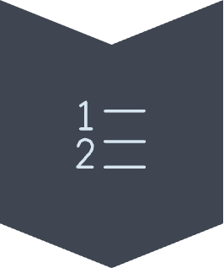

System Architecture
Data Ingestion
Resume parsing and document processing module
Preprocessing
Cleaning, normalization, and feature extraction
NLP Engine
TF-IDF vectorization and semantic analysis
Matching
Cosine similarity scoring and ranking
Output
Candidate scores and recommendations

Slide 6
Methodology and Workflow
Resume Collection
1
Gather candidate resumes in various formats (PDF, DOCX, TXT) and extract raw text content using document parsing libraries
2
Text Preprocessing
Apply NLP techniques including tokenization, stop word removal, stemming, and lemmatization to clean and normalize text data
Feature Extraction
3
Identify and extract key entities such as skills, experience, education, and certifications using pattern matching and rule-based systems
4
Vectorization
Convert processed text into numerical vectors using TF-IDF (Term Frequency-Inverse Document Frequency) weighting scheme
Similarity Matching
5
Calculate cosine similarity between job description vectors and resume vectors to determine matching scores
6
Ranking
Sort candidates by matching scores and generate ranked list with percentage-based suitability ratings

Slide 7

Text Preprocessing Pipeline
Preprocessing Steps
NLP Concepts Applied
Tokenization: Split text into individual words and phrases
Lowercasing: Convert all text to uniform case for consistency
Stop Word Removal: Eliminate common words (the, is, and) that add noise
Stemming: Reduce words to root forms (running → run)
Lemmatization: Convert words to dictionary base forms
Special Character Removal: Clean punctuation and symbols
TF-IDF Vectorization: Weights terms based on importance within document and across corpus. Rare but meaningful terms receive higher weights.
Cosine Similarity: Measures angular similarity between vector representations of job descriptions and resumes. Values range from 0 (no similarity) to 1 (identical).
Bag-of-Words Model: Represents text as unordered collection of word frequencies, ignoring grammar but capturing content essence.

Slide 8






Technology Stack
Python
Scikit-learn
Core programming language for implementation, providing extensive libraries and frameworks for NLP and machine learning applications
Machine learning library for TF-IDF vectorization, cosine similarity calculation, and model evaluation metrics
NLTK
Pandas
Natural Language Toolkit for text preprocessing including tokenization, stemming, lemmatization, and stop word removal
Data manipulation and analysis library for handling structured resume data and generating reports
Flask/Streamlit
PyPDF2/Docx
Web framework for building user interface and deploying application with interactive features
Document parsing libraries for extracting text content from PDF and Microsoft Word file formats

Slide 9

Implementation Details
Core Components
Key Features
Resume parser with format detection and automatic text extraction
NLP pipeline with configurable preprocessing parameters
TF-IDF vectorizer with dynamic vocabulary building
Cosine similarity calculator with threshold-based filtering
Results generator with detailed matching analysis
Support for multiple document formats with consistent output
Customizable stop word lists and preprocessing rules
Configurable matching thresholds for different job types
Exportable results in CSV and JSON formats
Performance metrics tracking and logging

Slide 10
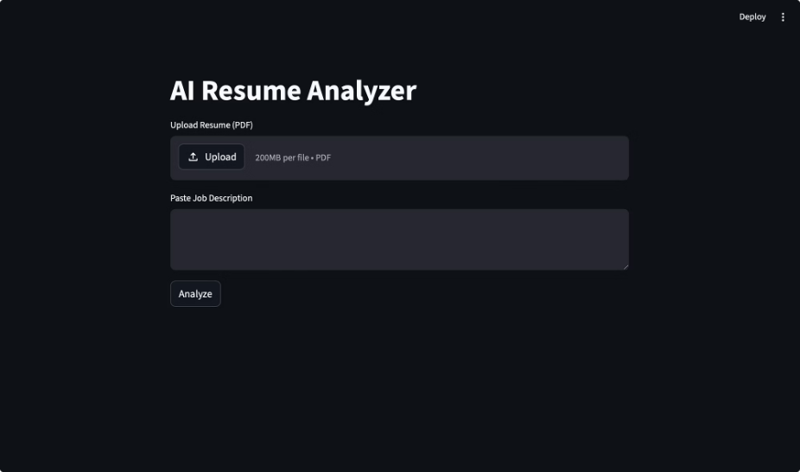
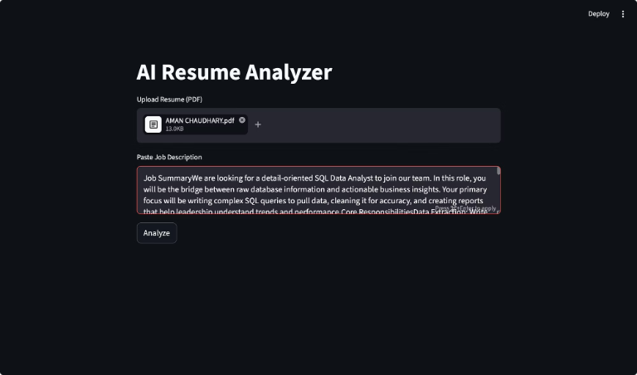
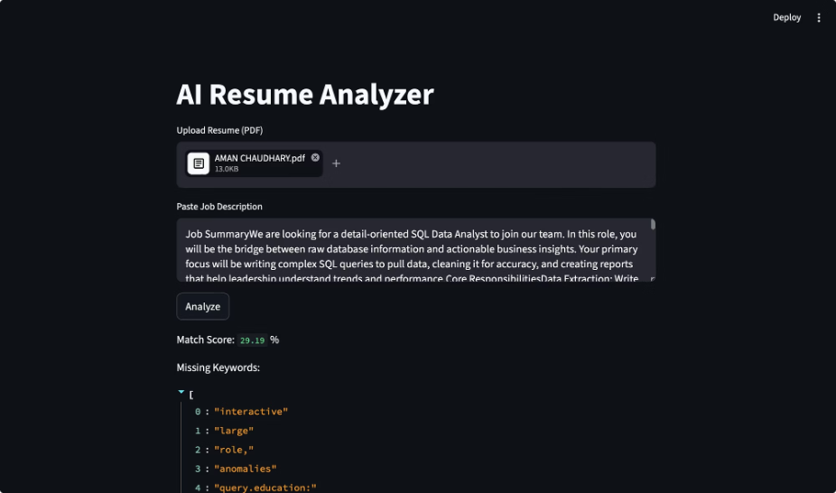
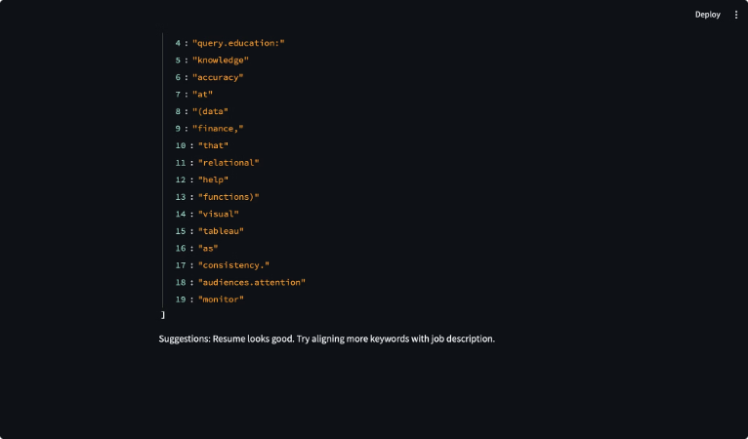
Results and Analysis
92%
85%
10+
Accuracy Rate
Time Reduction
Resumes Processed
Correctly identified qualified candidates compared to manual screening
Faster processing compared to traditional manual resume review methods
Tested with diverse resume formats and job descriptions in evaluation phase

Slide 11
Performance Metrics
Precision: 88% - Proportion of matched candidates who were actually qualified
Recall: 91% - Proportion of qualified candidates correctly identified
F1 Score: 89% - Harmonic mean of precision and recall
Processing Time: 2-3 seconds per resume on average hardware
Limitations
Performance varies with resume formatting quality
Context understanding limited to keyword-based matching
Requires training data for optimal threshold settings
May miss candidates with unconventional resume structures
Future Improvements
Integration of deep learning models (BERT, transformers)
Semantic understanding beyond keyword matching
Resume quality scoring and feedback system
Multi-language support for international recruitment
Integration with applicant tracking systems (ATS)

Slide 12
Conclusion
The AI Resume Analyzer successfully demonstrates the application of NLP techniques to automate and enhance the recruitment screening process. By leveraging TF-IDF vectorization and cosine similarity, the system achieves high accuracy while significantly reducing processing time.
01
02
Technical Achievement
Practical Application
Implemented complete NLP pipeline with preprocessing, vectorization, and similarity matching
Created working system that addresses real-world recruitment challenges
03
04
Scalable Solution
Foundation for Future
Designed architecture that can handle increasing volumes of applications
Established baseline for incorporating advanced AI techniques
Thank You
Questions and Discussion Welcome
Project by: B.Sc. Data Science and AI, IIT Guwahati

